Slide 1
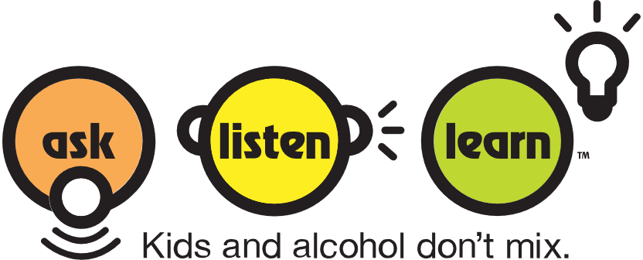
Alcohol and Your Developing Brain
An exploration of how alcohol affects the developing brain for:
Grades 4-7

Slide 2
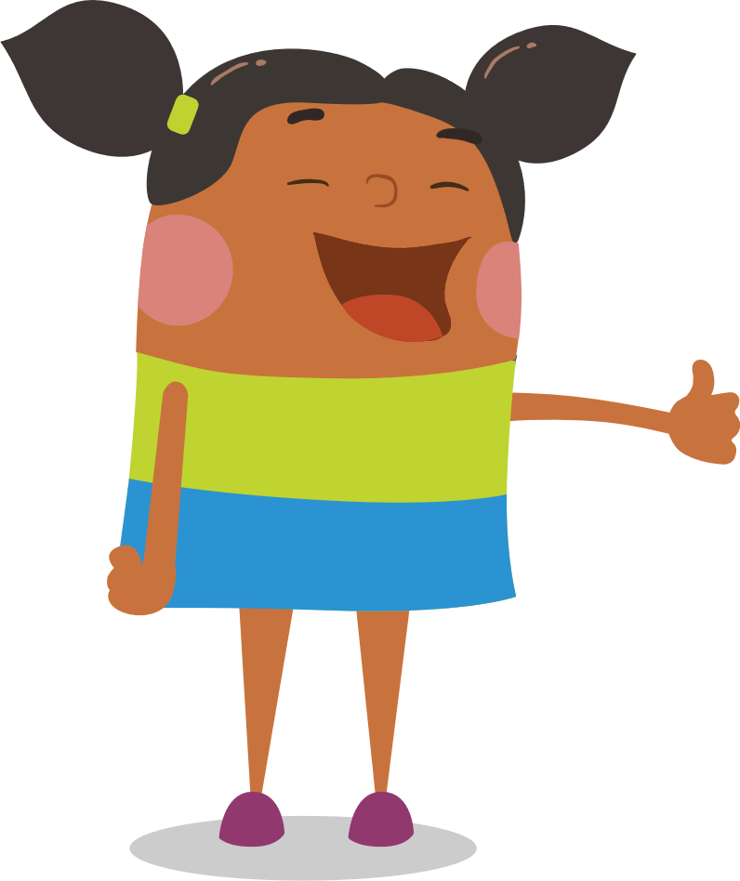
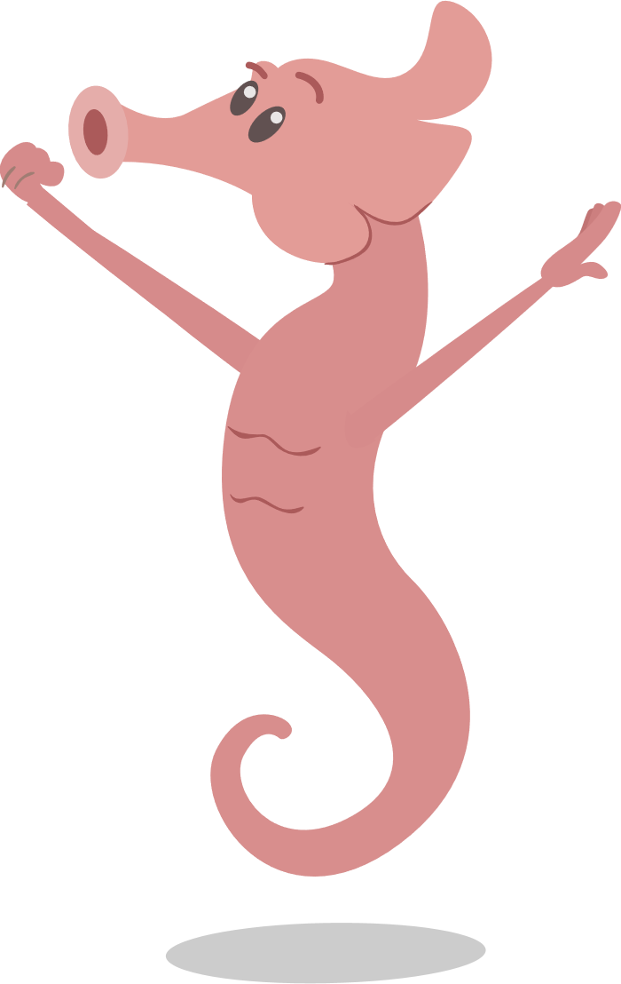
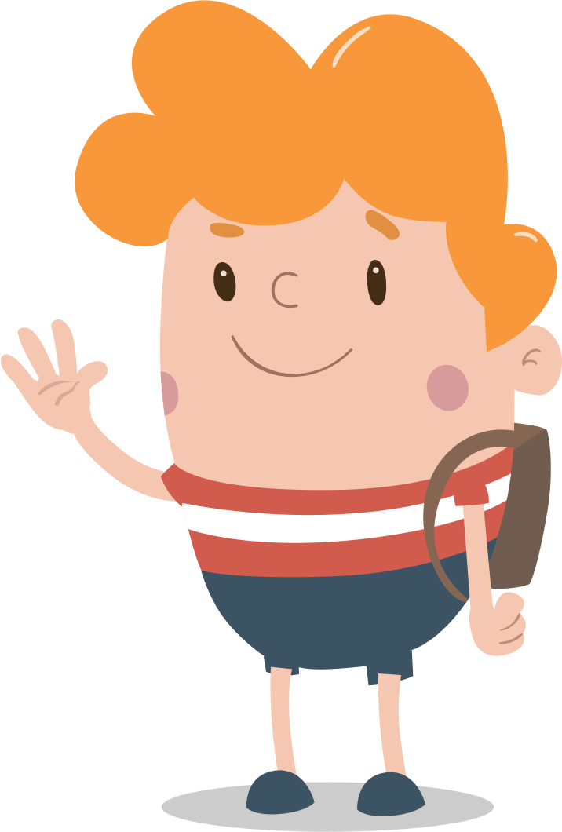
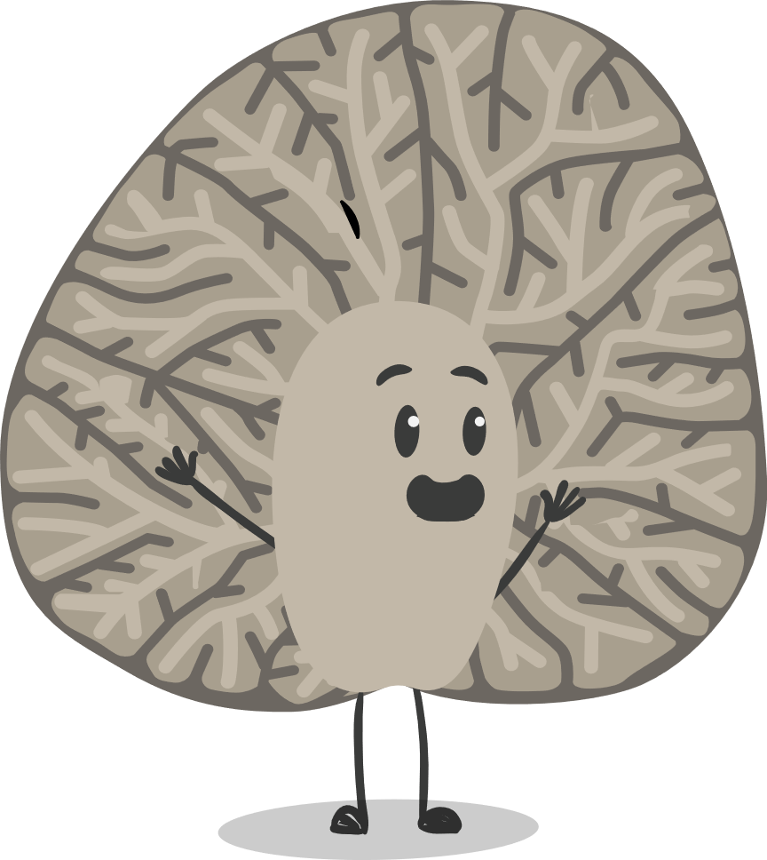
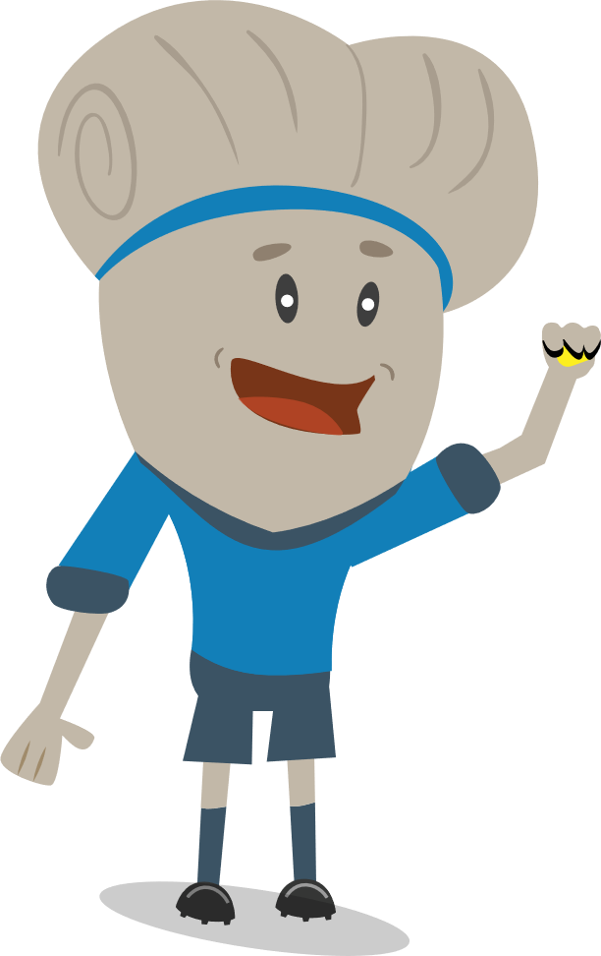
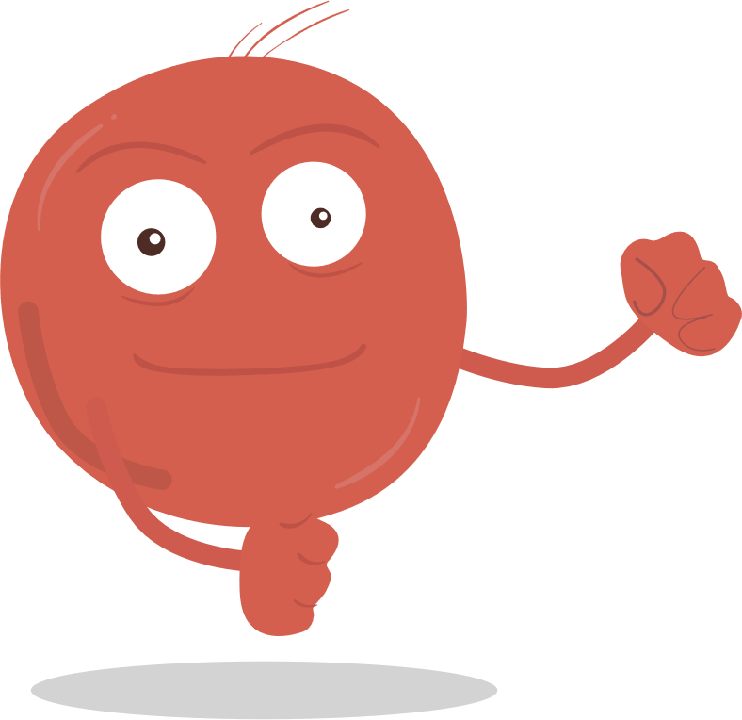
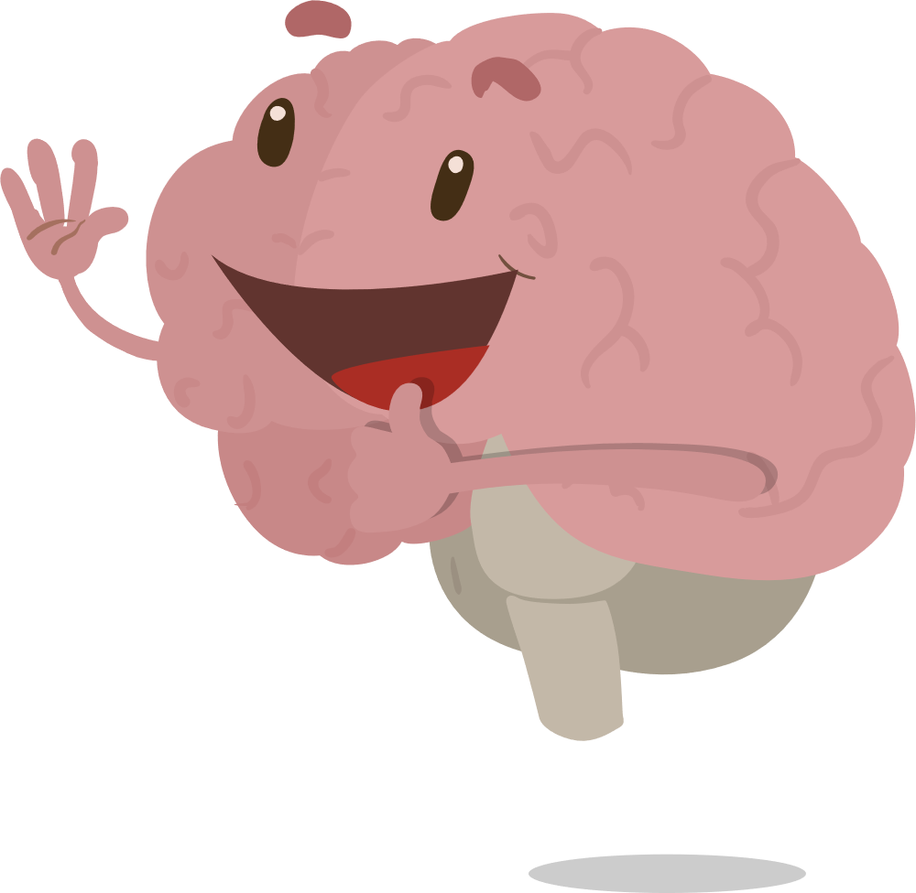
Pre-Lesson Activity: Neurotransmitter Tag
Separate half the class into the A-Team, a quarter of the class into the E-Team, and the remaining quarter into the I-Team. Have the I-Team and E-Team line up on one side of a classroom or outdoor play area.
After playing, discuss the following as a group:
What happened during the game?
What patterns did you notice?
Was that a balanced or fair game?
1
2
Team I
Team E
Team A

Slide 3
How Alcohol Affects the Developing Brain
1
What is neuroscience?
2
What do you think “vital involuntary actions” are? What are two examples from the video?
3
What are the two types of neurotransmitters?
4
Does alcohol slow down or speed up brain function?
5
Summarize the overall message of the video.

Slide 4
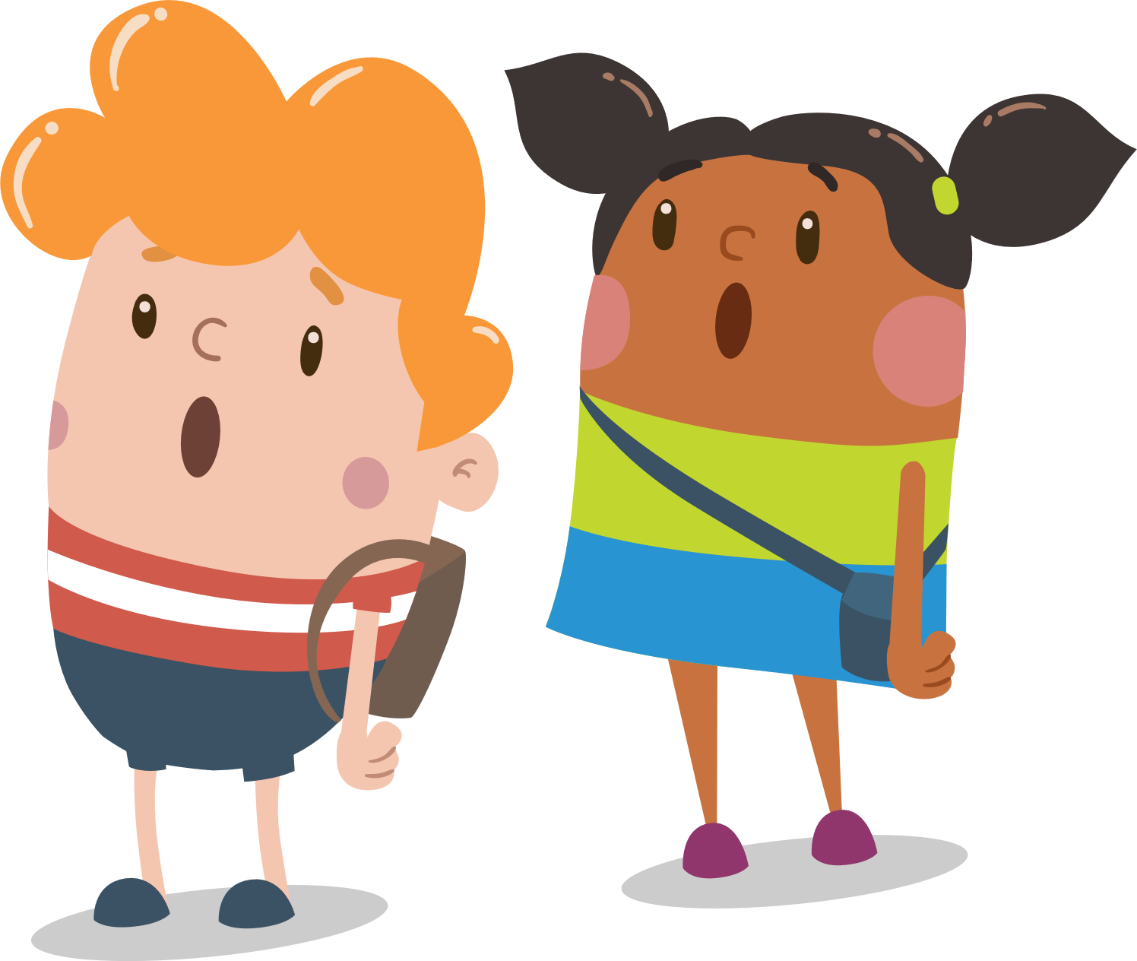
Discussion
Students: get into groups to discuss your answers to the comprehension questions.
Discussion:
Why do you think we played that game at the beginning of the lesson?
What did the three different teams represent?

Slide 5
Activity: Neuron Bobsled
Students (in groups of 5-6) stand behind one another with their hands on each other’s shoulders, in a conga line.
Tell students, “Neurotransmitters go!” and the groups will all start walking around the room any way they want to go, being careful not to run into another group.
Rules:
When you say “excitatory” students will move at a faster pace.
When you say “inhibitory” students will move at a slower pace.
When you say “balanced” students will move at a moderate pace.

Slide 6
Discussion
What are the functions of inhibitory neurotransmitters?
What are the functions of excitatory neurotransmitters?
What happens to neurotransmitters when alcohol is in the mix?
What connections can you make to the first game?

Slide 7
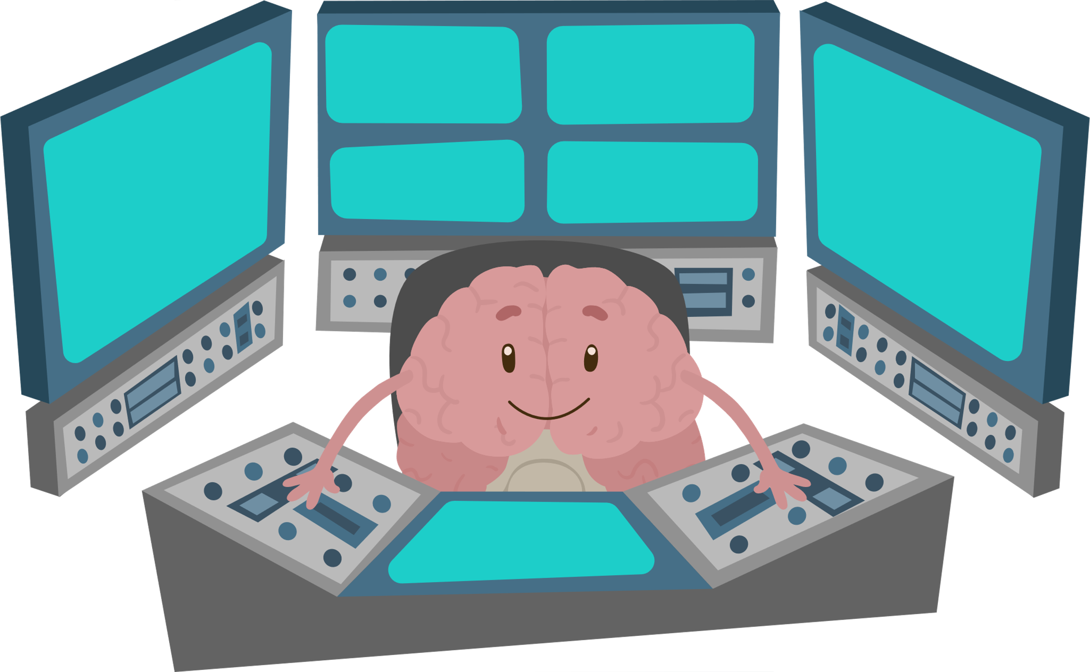
Additional Videos and Games
Watch the rest of the Ask, Listen, Learn brain videos!
Visit our games page for more educational activities!

